Slide 1



Visualizing the Evolution of the NBA
Data Visualization • Analytics • Storytelling
Author: Anurag Surve
Course: DATS 6401 – Visualization of Complex Data
Instructor: Dr. Reza Jafari
Institution: George Washington University
Term: Fall 2025

Slide 2
Project Overview
Objective of the Final Term Project
Apply Python-based visualization techniques covered in DATS 6401 to a real-world dataset
Design an end-to-end visualization pipeline:
Data cleaning and preprocessing
Statistical analysis and static visualization
Interactive dashboard development
Cloud deployment for real-world usability
Use visualization to reveal hidden patterns in complex, high-volume NBA data
Emphasize storytelling, not just plotting

Slide 3
Why the NBA?
Why NBA Data is Ideal for Complex Visualization
Longitudinal dataset spanning multiple eras of basketball
Rich mix of:
Numerical variables (points, assists, shot attempts, percentages)
Categorical variables (teams, season types, eras)
Captures strategic evolution driven by:
Rule changes (3-point line, pace rules)
Analytics revolution
Team-level innovation
High relevance to:
Sports analytics industry
Media analytics
Performance optimization

Slide 4
Dataset Description
Dataset Overview
Source: NBA game-level historical data (game.csv)
Granularity: Game-level observations
Time span: 1946 – 2025
Key variables include:
Scoring: PTS, FGM, FGA
Playmaking: AST
Shooting: FG%, 3P%, FT%
Shot selection: 3PA share, 2PA share
Team identifiers (home and away)
Dependent Variables
Scoring metrics (PTS, FG3A, FG3%)
Independent Variables
Season, team, era, shot mix, efficiency metrics

Slide 5
Project Pipeline
End-to-End Workflow
Raw NBA data ingestion
Data cleaning and normalization
Feature engineering:
Season start year, Era labels, Team-level aggregates
Static exploratory visualization (Phase I)
Statistical analysis (correlation, PCA, normality)
Interactive dashboard development (Phase II)
Cloud deployment using Google Cloud Platform (Phase III)

Slide 6
Phase I: Static Data Analysis
Purpose of Phase I
Understand data structure before interactivity
Identify trends, distributions, and relationships
Validate assumptions using statistical plots
Static Visualizations Included
Line plots for temporal trends
Bar plots (grouped & stacked)
Count plots and pie charts
Distribution plots with KDE
Regression and density plots
Multivariate visualizations
Subplots for storytelling

Slide 7
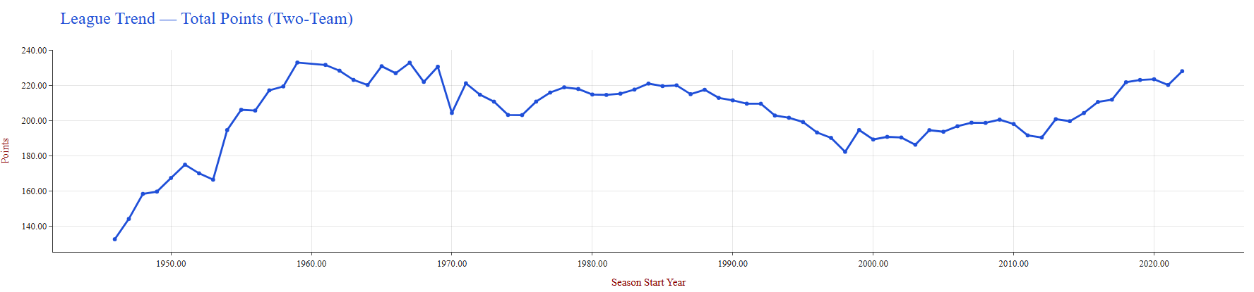
League-Wide Trends
What This Visualization Shows
Average league-wide trends over time
Metrics such as total points, assists, and shot attempts
Key Observations
Long-term upward trend in scoring
Clear dips during defense-oriented eras
Post-2010 acceleration aligned with pace-and-space basketball
Confirms that NBA offense has become faster and more efficient

Slide 8
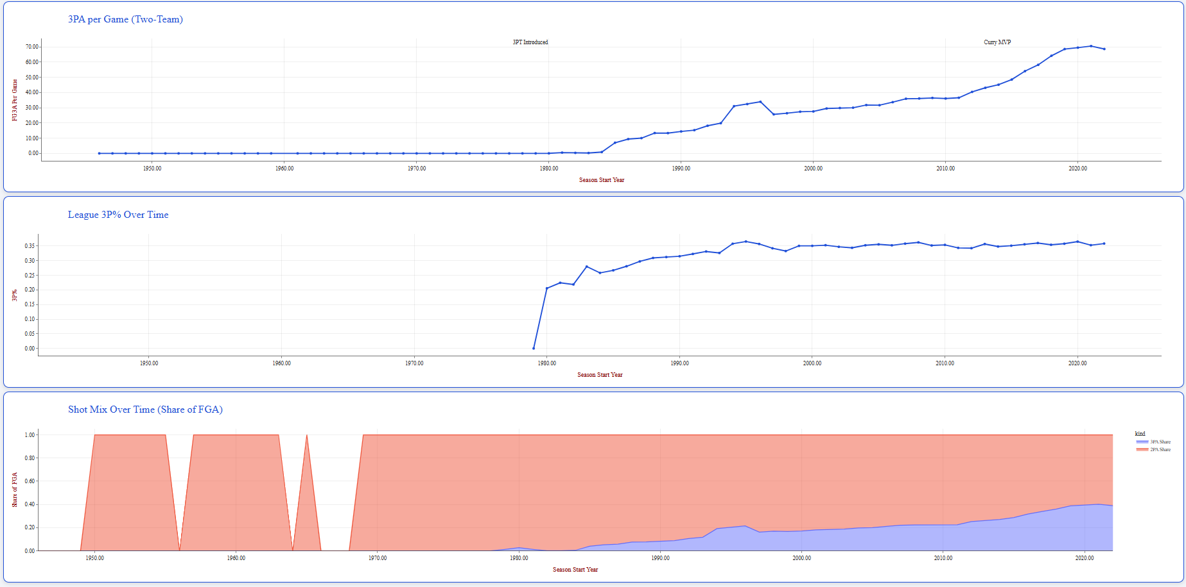
The Three-Point Revolution
Gradual adoption after introduction of the three-point line.
Rapid increase in attempts since the mid-2000s.
Three-point shots now dominate offensive strategy.

Slide 9
Phase II: Interactive Dashboard
The interactive dashboard was developed using Python Dash, enabling real-time data exploration without the need to re-run the underlying code.
Users can dynamically select metrics, teams, seasons, eras, and plot types, allowing flexible and customized analysis of NBA trends.
The dashboard integrates multiple visualization components, including line plots, bar plots, distribution plots, and density plots, all linked through callbacks.
Interactivity enhances understanding by allowing users to immediately observe how changes in inputs affect trends, distributions, and relationships in the data.
This phase transforms static exploratory analysis into a user-driven analytical tool, supporting both exploration and storytelling.

Slide 10
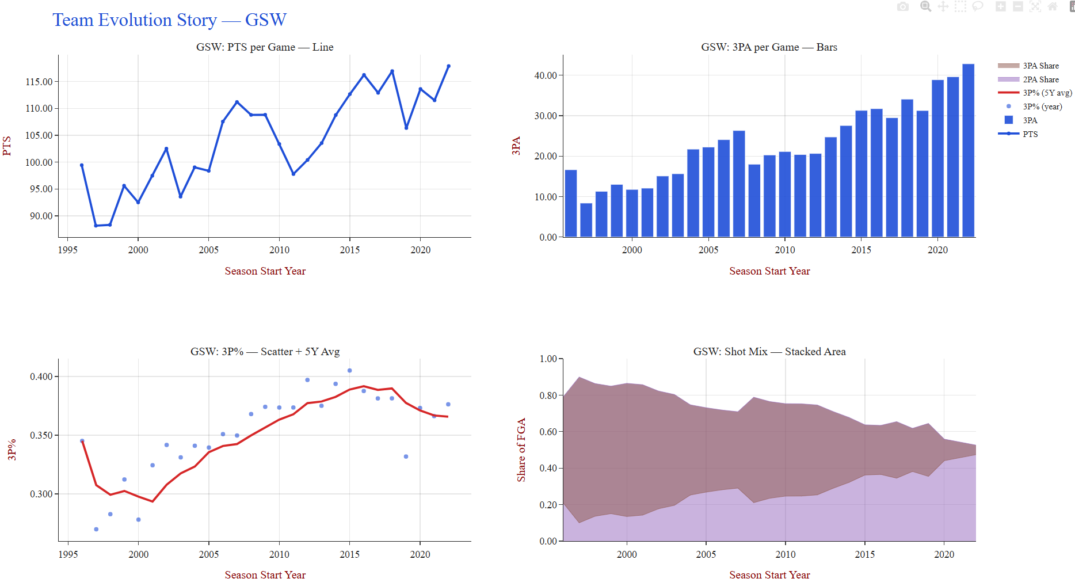
Team Evolution Story: GSW

Slide 11
Team Evolution Story: GSW
This visualization tracks the long-term evolution of the Golden State Warriors by combining scoring trends, shooting volume, efficiency, and shot selection into a single storytelling view.
The points-per-game line plot shows a clear increase in offensive output over time, particularly during the mid-2010s, reflecting the team’s transition into a high-efficiency, high-spacing offensive system.
The bar chart of three-point attempts per game highlights a substantial rise in long-range shooting, indicating a deliberate strategic shift rather than random variation.
The three-point percentage scatter plot with a moving average demonstrates that increased three-point volume did not come at the cost of efficiency, reinforcing the effectiveness of analytics-driven shot selection.
The stacked area plot of shot mix confirms a structural transformation in offensive philosophy, with three-point shots replacing a significant portion of traditional two-point attempts over time.
Overall, this team-level analysis illustrates how the Warriors successfully adapted to modern, analytics-driven basketball and serves as a concrete example of how strategic innovation can translate into sustained competitive success.

Slide 12
Phase III: Deployment on GCP
The dashboard application was containerized using Docker to ensure consistent execution across different environments.
The containerized app was deployed using Google Cloud Run, enabling scalable and serverless deployment.
Cloud Run manages infrastructure automatically while supporting real-time user access.
The deployed dashboard is accessible through a public web URL, allowing users to interact with the application without local setup.
This phase demonstrates the transition from analysis to a production-ready data application.

Slide 13
Dashboard Walkthrough
Visualizing the Evolution of the NBA (1979–2023)

Slide 14
Key Takeaways
NBA strategies have evolved significantly in response to data-driven insights, particularly in shot selection and offensive pacing.
Visualization techniques make long-term trends and structural changes visible, revealing patterns that are difficult to detect in raw statistics alone.
Interactive dashboards enhance both exploratory analysis (discovering patterns) and explanatory analysis (communicating insights clearly).
Combining statistical analysis with visualization leads to more informed and interpretable decision-making.

Slide 15
Conclusion
This project demonstrates a complete end-to-end analytics pipeline, from raw NBA data to deployed interactive visualizations.
By combining statistical analysis, visual storytelling, and dashboard interactivity, the project highlights how basketball strategy has evolved over time.
The interactive dashboard enables users to explore league-wide trends and team-level narratives in a flexible and intuitive way.
The overall framework is scalable and extensible, making it applicable to other sports, seasons, and large-scale datasets.

